Slide 1

Bringing It All Together and Where to Go Next

Slide 2

How does it all fit together?
Outline
Service Discovery
Distributed Configuration
Client-side load balancing
Gateway and routing
Fault tolerance and circuit breaker
What’s next?
- Other Spring Cloud Projects

Slide 3
How Does It All Fit Together?

Slide 4



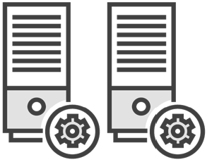


The Parts of a Cloud Native System
Discovery
Gateway
Config
Service A
Service B

Slide 5
Putting It All Together: On Startup

Slide 6
Putting It All Together: On Startup
Discovery
Gateway
Config
Service A
Service B

Slide 7
Putting It All Together: On Startup
Discovery
Gateway
Config
Service A
Service B

Slide 8
Putting It All Together: On Request

Slide 9
Putting It All Together: On Startup
Discovery
Gateway
Config
Service A
Service B

Slide 10
What’s Next?

Slide 11


Spring Cloud Config
Spring Cloud
Spring Cloud Netflix

Slide 12
Spring Cloud Bus
Spring Cloud Task
Spring Cloud Cluster
Spring Cloud
More…
Spring Cloud Consul
Spring Cloud Sleuth
Spring Cloud Stream
Spring Cloud Security

Slide 13
http://projects.spring.io/spring-cloud

Slide 14
